Slide 1

Project Proposal: Designing A Cost-Efficient Tidal Turbine in Savoonga, Alaska

Slide 2
Designing A Cost-Efficient Tidal Turbine in Savoonga, Alaska
Designed By
T’erra Eubanks (Architectural Engineering Major)
- Provides construction documents of the design model.
Shifan Arbar Rashid (Computer Science Major)
- Provides code documents for any technical supports of the design model necessary.
Alex Laird (Environmental Engineering Major)
- Provides any environmental information needed for the design model such as location, placement, and any environmental information required for the design model.

Slide 3
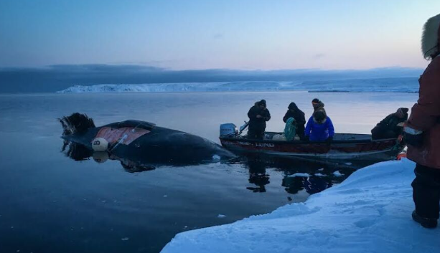
Population and Region
Description/Analysis
Location:
Savoonga, Alaska is a remote village located on St. Lawrence Island in the Bering Sea
Population:
Approximately 794 residents as of 2024
Demographics:
Median age 24.5 years, indicating a young population.

Slide 4

Current Electricity Usage And Cost
Economic Overview
Currently, Savoonga’s electricity is generated primarily through diesel fuel, which must be transported long distances, making it extremely costly.

Slide 5

Challenges With Current Energy Sources
They have a higher percentage rate in electricity usage.

Slide 6
Benefits of Creating a Tidal Turbine - Reduce Dependence on Diesel: With a renewable and consistent energy source, Savoonga can cut back on diesel consumption, leading to lower fuel costs. - Lower Energy Bills: With access to a natural power source, residents will see reduced electricity rates over time, making household energy more affordable. - Improve Energy Security: A local renewable energy source reduces the risk of fuel shortages and price fluctuations, ensuring more reliable electricity access.

Slide 7
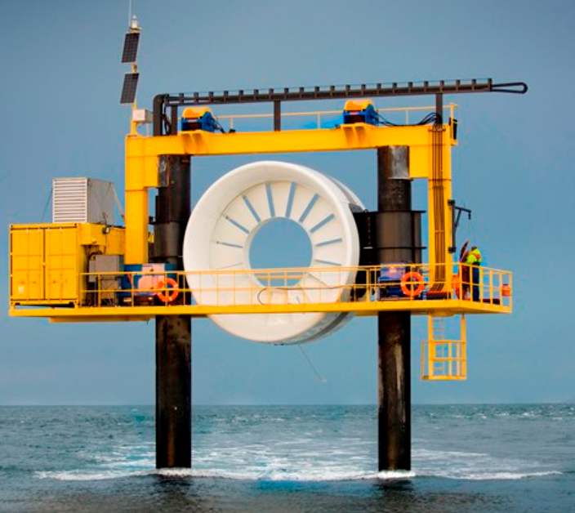
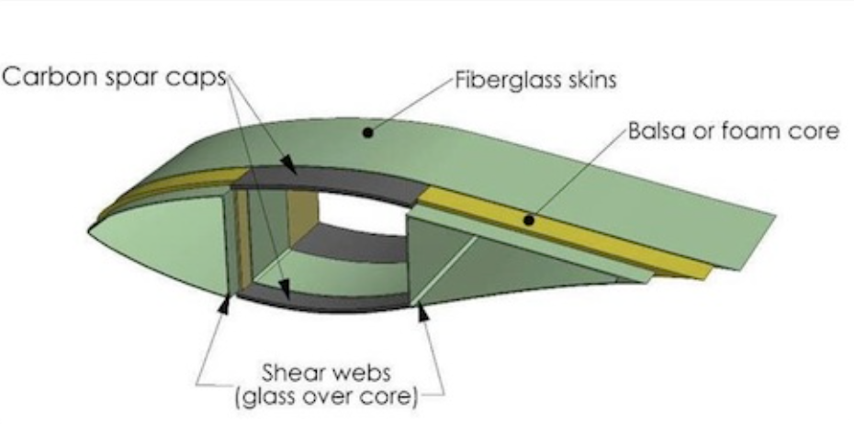
Strategy for Design Model
We will study the requirements that is needed for a Tidal Turbine
Find alternative materials from previous models that is cost efficient and manageable.

Slide 8
Project Cost $3000 to $5000 per Kwh of capacity to produce 250 Kwh

Slide 9
